Slide 1

AI GYM TRAINER
-ADITYA BHARDWAJ, DEEPTI HEGDE, HARSHIT WADHWANI, SEJAL KAUR VIRDI

Slide 2
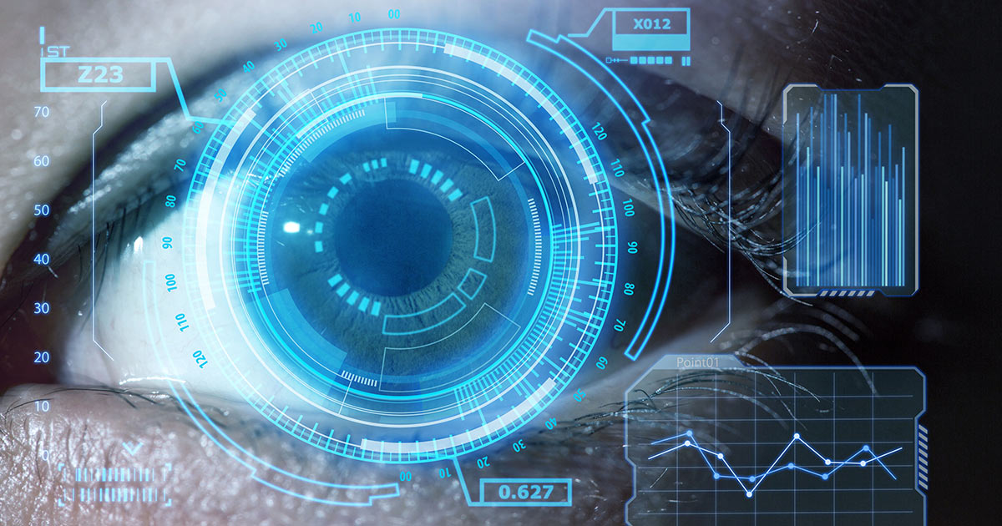
CONTENTS
Introduction
Objective
Literature Review
Proposed Work
Scope of Projects
Front end and Back end
Advantages
Limitations
References

Slide 3
INTRODUCTION
Fitness must be an integral part of everyday life. Normal life in the urban jungle is often sedentary and leads to various illness and health complications.
An application that can track , monitor and supervise daily exercise and suggest suitable exercise regime is the need of the hour.
Most applications require constant feedback and input from the user without live tracking of workout sessions.
Even though the applications are able to set goals and make routines, they do not monitor the actual workout or correct wrong and harmful postures.

Slide 4
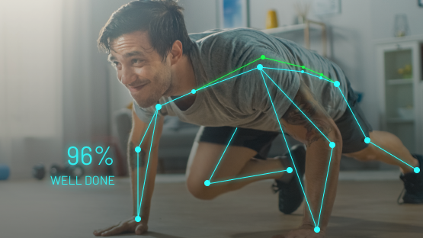
OBJECTIVE
We aim to design a virtual gym trainer that works hands free
So that users have a maximum utilisation of their personalised workout regime.
The virtual trainer will set personalised target goals and workout routines.
The trainer will constantly monitor live workout sessions of the user and correct posture/technique and give warnings for injurious positions/behaviour.
The aim of the project is to have a hands free automatic virtual gym trainer that is personalised to the uuser.

Slide 5
LITERATURE REVIEW
Pate reviewed the previous literature and reported that they all focused on defining physical fitness in terms of movement capacities.
In addition , Caspersen et ai. and Vancampfort et ai. Indicated that physical fitness was a set of attributes that people had or achieved related to the ability to perform physical activity, and it could reduce the risk of developing diseases associated with physical inactivity.
A study by Pate reported that in mid 1970’s a trend towards HRPF (Health Related Physical Fitness) began and in 1980 a new test was developed.

Slide 6
CONTINUATION….
Pate and Caspersen et ai. Further indicated that the health related components of physical fitness were cardiorespiratory endurance, body composition , muscular strength and flexibility.
In another study it was pointed out that people with good physical fitness would have the characteristics of better cardiorespiratory endurance, body composition , muscular strength and flexibility.
Furthermore , physical fitness referred to the individuals health and energy status , enabling participation in various types of physical activity in daily life.

Slide 7
Tech Requirements
OpenCV
CNN
BlazePose

Slide 8
PROPOSED WORK
Creating account
User Personalisation
Goal setting
Pre-Set Exercise Routine
Calories and Water Intake count
Give Free health and Fitness Tips
Keep User Motivated

Slide 9
SCOPE OF project
The main purpose of this project is to develop an online fitness application- FITNESS APP
This application will guide the user about correct exercise postures thus giving proper guidance.
With this application user can make use of the following benefits:
Can assess his/her way of exercising.
Accuracy of yogic postures.
Lead a healthier life style

Slide 10

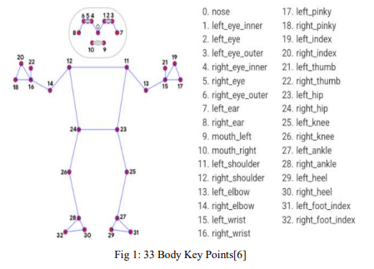

Slide 11
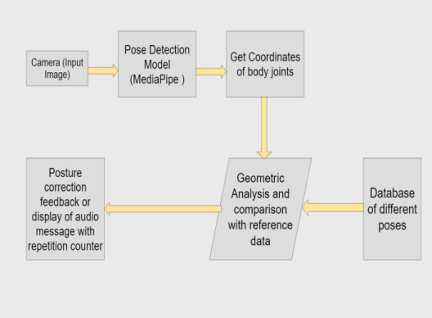

Slide 12
ADVANTAGES
1. There are numerous applications available in the market which guide the user about the exercises to be performed. But through this application, we not only guide the user regarding which exercise to perform but also about the correct posture and counting the repetitions using computer vision.
2. Monitor the user in real-time keeping track of the quality repetitions of a particular exercise, thus keeping his form intact and correct throughout their workout. This will educate newbies about different exercise routines and their correct postures to prevent injuries.
3. The application also offers personalized health advice and nutrition ideas while keeping the daily calorie log in the database.
4. The application can not only be used by individuals at homes but by increasing the scope can be used in gyms as smart trainers thus reducing the human intervention.
5. Our main motive is to spread awareness about the importance of good health and fitness among common people.

Slide 13
FRONT AND BACK END
FRONT END:
Streamlit is an open-source app framework for machine learning and Data Science project.
Streamlit’s simple and focused API lets you build incredibly rich and powerful tools.
Streamlit lets you turn data scripts into sharable web apps in minutes, not weeks..
BACK END:
Python is a programming language which can be used on a server to create web applications.
It supports multiple programming paradigms, including structured, object oriented and functional programming.
We’ll be using OpenCV library and Convolutional Neural Networks(CNN) to develop this project.

Slide 14
LIMITATIONS
1. The application can estimate the poses and count repetitions for a limited number of exercises as pose estimation using computer vision for some exercises and postures can be difficult.
2. The application is developed as a cross-web application and is not used as a mobile android/iOS application.
3. The application cannot capture multiple people in the frame in the real-time system.

Slide 15
BLOCK DIAGRAM
1. User Login: The user has to enter valid credentials and login into the system and save the personal data of the user into the respective account.
2. Exercise Routines: The application contains different exercise routines which have different exercises that the user can do in real-time and has different pose correction and set repetition counter tools.
3. Repetition counter: It counts the set of repetitions the user does of a particular exercise in real-time by identifying the position of the user.
4. Pose corrector: it helps the user to detect and correct the poses or the exercise posture of the user in real-time by using different pose detecting algorithms and computer vision techniques.
5. Diet Recommendation: The system prepares a diet plan for the user depending upon the health Issues and the area of interest.
6. Personal Recommendation and record log: The system monitors the daily calorie loss and the exercise count repetitions of the user and does the research of the data to give relevant reports to the person and thereby increase the precision in the recommendations.

Slide 16
DATASET USED:
As most of the solutions use the key points and the heatmaps, first we require to pose alignment data for each pose. We can take into consideration the different test cases where if the complete body is visible and there are detectable key points for the body parts. To make sure that the pose detector can perform in heavy occlusions which are some different test cases than normal ones, we can make use of occlusion simulating augmentation. The training data set has 60000 images with a few images doing the same pose that have different key points and 25000 frames in which the user performs the actual exercise.

Slide 17

OPENCV
OpenCV (Open Source Computer Vision Library) is a library of programming functions mainly aimed at real-time computer vision.^{[1]} Originally developed by Intel, it was later supported by Willow Garage then Itseez (which was later acquired by Intel^{[2]}). The library is cross-platform and free for use under the open-source Apache 2 License. Starting with 2011, OpenCV features GPU acceleration for real-time operations.

Slide 18

Thank You

